Slide 1












Classification of News Articles Using NLP Techniques and Machine Learning Algorithms: Comparative Study
Ali M. Ahmed Al-Sabaawi
Software Dept., Faculty of Information Technology, Nineveh University
Hanan S. Mohamad Zakariya Software Dept., Faculty of Information Technology, Nineveh University
Raheed F. Putrus Bizo Software Dept., Faculty of Information Technology, Nineveh University
Shahad A. Abdalhaleem Al-Mashhadani Software Dept., Faculty of Information Technology, Nineveh University

Slide 2



Introduction
The primary purpose of news is to keep people informed about events that are taking place in their environment that may influence them.
Individuals have their own preferences for news categories based on different interests.
People read the news for various reasons—some to stay informed about current events, others to prepare for exams, or simply as a hobby.

Slide 3
Importance of news classification
Information Filtering and Personalization.
Fighting Misinformation and Fake News.
Support for Policy Making and Crisis Management.
Advertising and Revenue Optimization.

Slide 4
Problem statement:
Three problem statements highlighted in this study.
How to build a model to classify news articles according to their contents ?
How to extract features from news articles?
How to evaluate the classification models performance?

Slide 5
Project objectives:
To classify news using three algorithms: SVM, NN, RF.
To exploit two types of feature extraction (TF-IDF and BOW) that can extract a meaningful information and remove others.
To use precision, recall, f-score, and time metrics for evaluation models.

Slide 6
Methodology:
Testing data 20%
News Articles
Data cleaning and preprocessing
TF-IDF & BOW vectorization
Training data 80%
Applying
SVM
NN
RF
News Category Classification
Evaluation

Slide 7
TF-IDF Example:
is a numerical statistic method that reflects the importance of a word in a document.
It considers two primary factors: a word's frequency within a document (TF) and its frequency throughout the corpus of documents (IDF).
We will cover an example of three documents:
Document 1: It is going to rain today.
Document 2: Today I am not going outside.
Document 3: I am going to watch the season premiere.

Slide 8
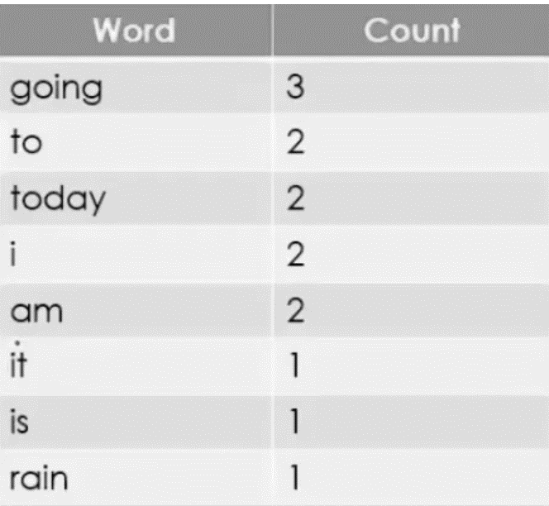
TF-IDF Example:
1. Clean data and Tokenize:

Slide 9
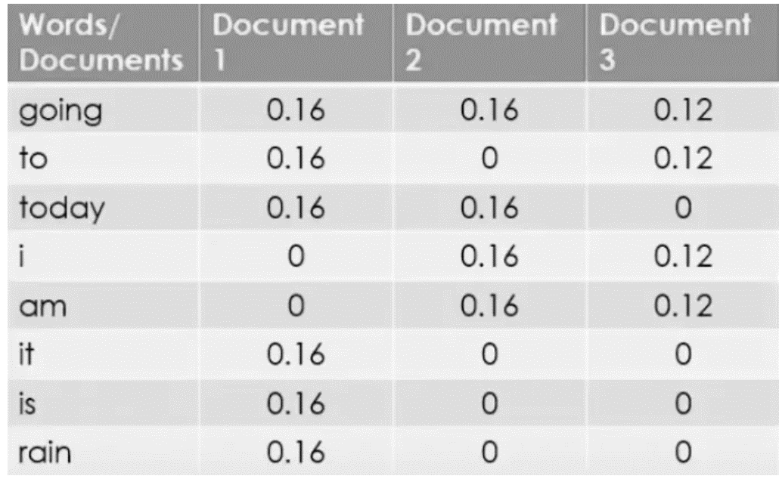
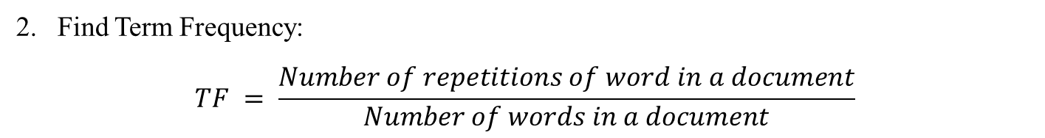
TF-IDF Example:
Find Term Frequency:
$$TF = \frac{Number of repetitions of word in a document}{Number of words in a document}$$

Slide 10
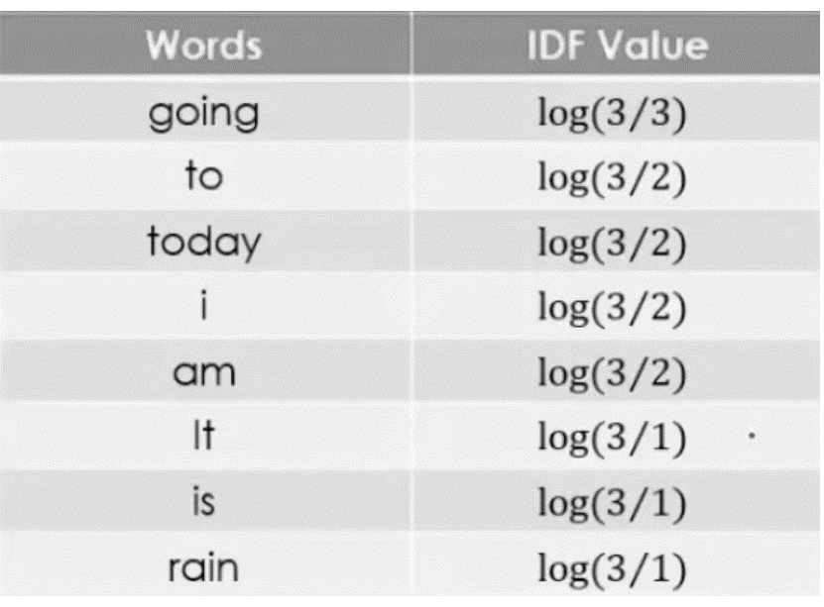
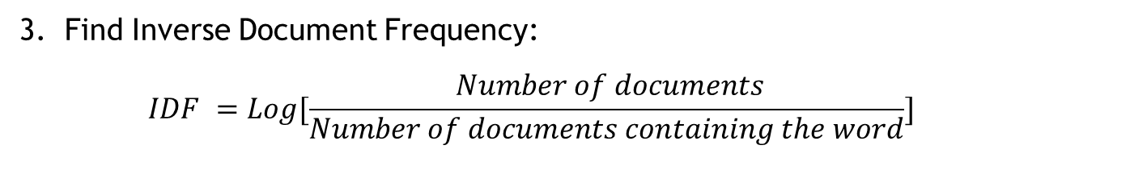
TF-IDF Example:
3. Find Inverse Document Frequency:
$$IDF =Log[\frac{ Number of documents}{Number of documents containing the word}]$$

Slide 11
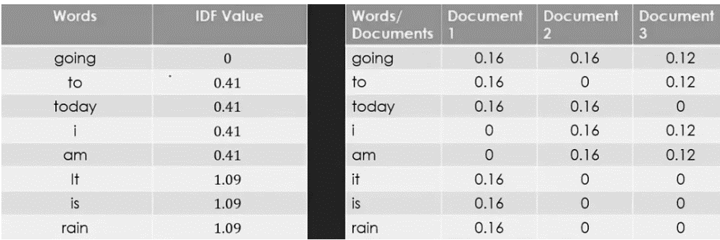
TF-IDF Example:
4. IDF and TF values for three documents:

Slide 12
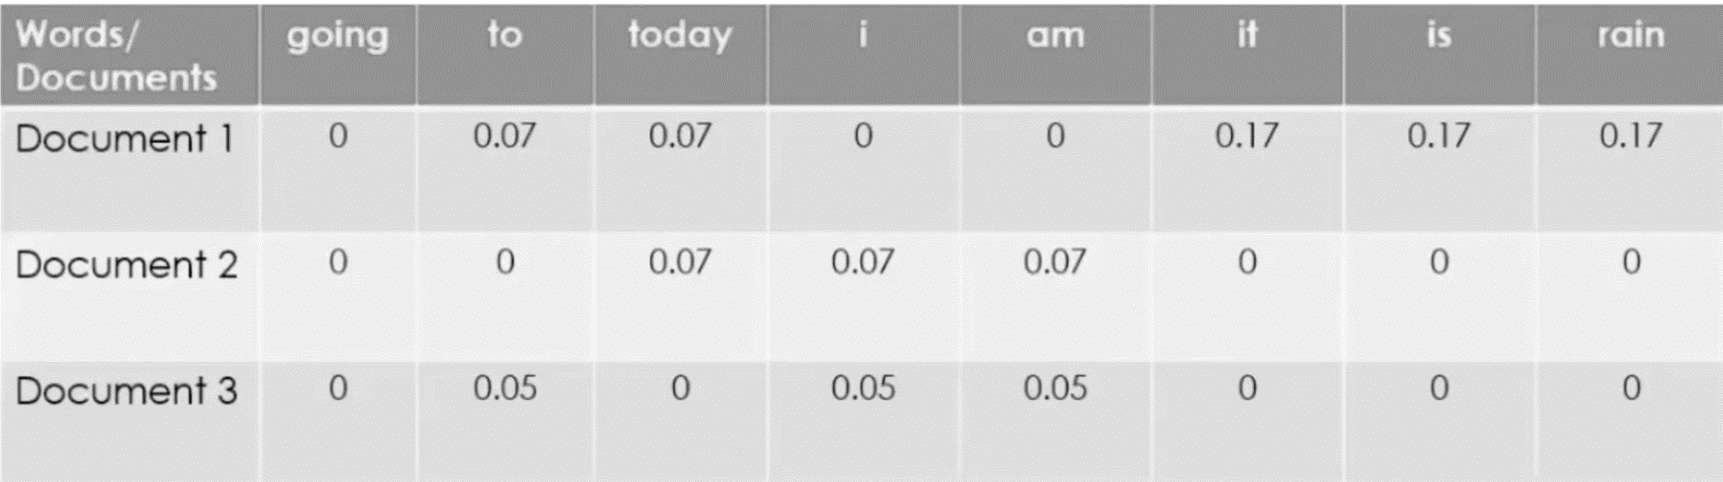
TF-IDF Example:
Calculate the final equation & compare result:
$$TF−IDF = TF ∗ IDF$$

Slide 13
TF-IDF Example:
Word frequency within a document (TF) and its frequency throughout the corpus of documents (IDF).
We give each word a score that represents its significance within the document and corpus. Depending on this significance values the document will be classified to its belonging class.

Slide 14
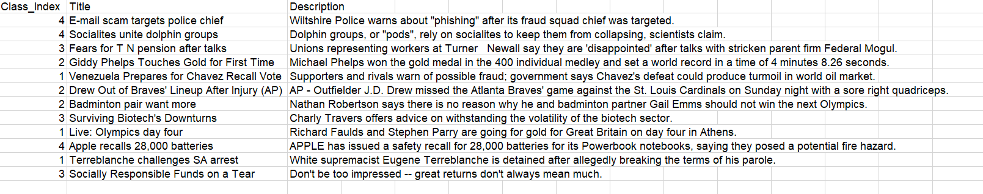
Dataset:
The AG News Classification Dataset is about news articles, it has 4 classes type either World, Sports, Business or Sci/Tech.
Our dataset has 120,000 records they're divided into two parts 80% for training and 20% for testing, evenly distributes across the four classes.

Slide 15
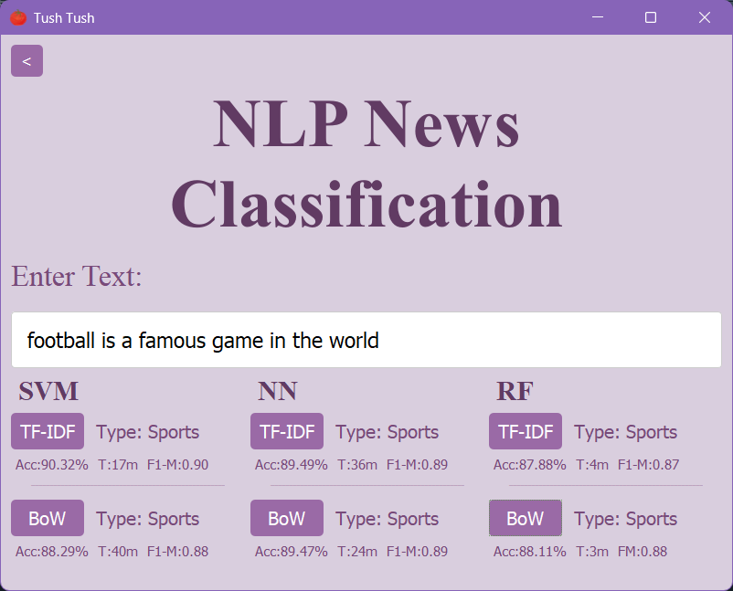
GUI:

Slide 16
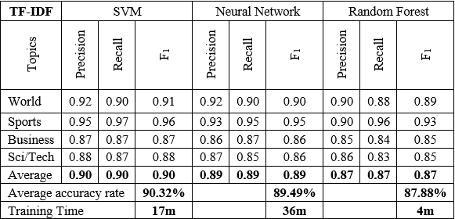
Results and Recommendations
Results table TF-IDF

Slide 17
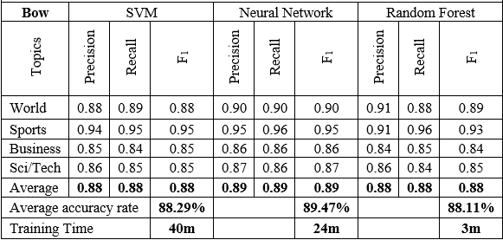
Results and Recommendations
Results table BOW

Slide 18
Results and Recommendations
TF-IDF comparison results

Slide 19
Results and Recommendations
BOW comparison results

Slide 20
Results and Recommendations
The study classifies news articles into four categories using SVM, Neural Networks, and Random Forest algorithms.
Results show that SVM with TF-IDF achieves the highest accuracy, making it ideal when precision is key.
Random Forest with BOW is faster and suitable for efficiency-focused tasks with moderate accuracy.
Neural Networks perform well but require significant computational resources, fitting for large-scale setups.
Future work could explore combining TF-IDF and BOW or hybrid models, along with testing on additional datasets for more robust evaluation.

Slide 21
Thank you

